Slide 1
Avoid the mine
By:
1. H.M. Jameul Haque Jilan
Roll: FH-30
2. Safayat Ullah
Roll: SH-40

Slide 2
Avoid the mines
Introduction:
Name of the project: ‘Avoid the mine’
Type: Simple puzzle game.
Origin: this game is actually produced based on the popular game “Minesweeper”, a windows 7 game.
Objective: The purpose of the game is to explore all the blocks those has not a mine.
How to play: The player just needs to click on a block to explore it. He/She will lose the game if any block with a mine is explored! When all the block are explored, excluding the blocks having mine, the player wins!

Slide 3
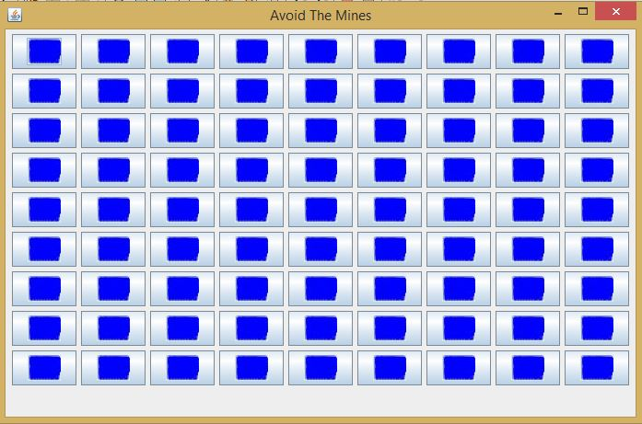
Avoid the mine
Description:
1. The background of the game is consist of 81 block arranged in 9 rows and 9 columns

Slide 4
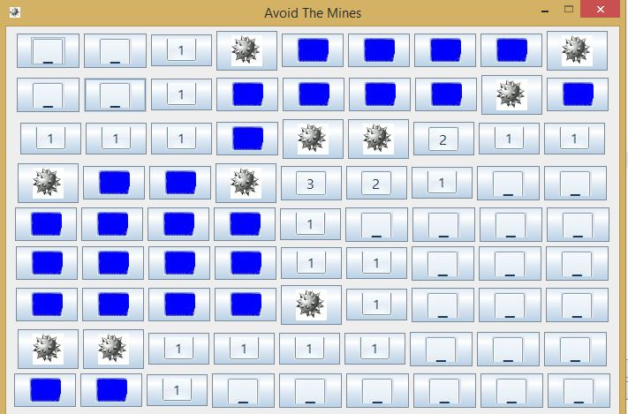
Avoid the mines
Description:
2. Only 10 of the blocks have a mine each.

Slide 5
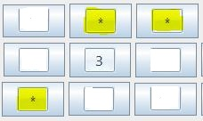
Avoid the mine
Description:
3. If the player opens a block that has no mine he/she will be given a number that represent the number of neighbor blocks having mine

Slide 6
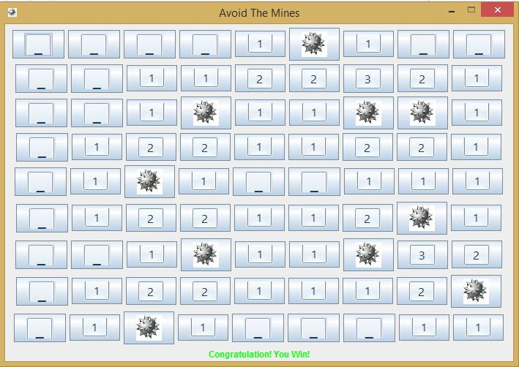
Avoid the mine
Description:
4. When the player explores all the blocks having no mine he/she will win!

Slide 7
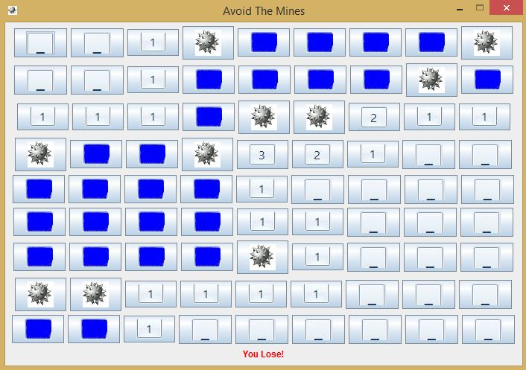
Avoid the mine
Description:
5. If the player explore any block having mine he/she will lose.

Slide 8
Avoid the mines
Thank You!

